Slide 1

FRTB · INTERNAL MODELS APPROACH · MAR31 RISK-FACTOR MODELLABILITY
Modellable or Not —
the RFET, Bucketing & the Road to IMA
Real prices, buckets, own-vs-regulatory elections, the seven data principles and the NMRF boundary — recorded walkthrough of a live Excel reference & calculator (MAR31.12–31.26, touching MAR32 / MAR33).
13
24 / 90d / 100
workbook sheets
the RFET thresholds
Market Risk — FRTB Programme · companion workbook: MAR31_RFET_Bucketing_Reference_v23.xlsx

Slide 2
SESSION 1
Why Modellability Exists
Excel sheets: 00_README · 05_why_real_prices

Slide 3
WHY THIS TEST EXISTS
EXCEL → 00_README
orientation
The RFET decides WHERE capital comes from — it is the per-risk-factor gate on the road to IMA
A trading desk wins Internal Models Approach (IMA) approval as a desk — but capital is computed from risk factors. Every single risk factor must separately prove it is modellable: evidenced by enough REAL market prices. The Risk Factor Eligibility Test (RFET) is that proof.
DESK GATE
backtesting + P&L attribution (MAR32) — desk-level
→
FACTOR GATE — RFET
≥24 real prices/yr + density, or ≥100 (MAR31.12–13)
→
DATA PRINCIPLES
7 ongoing conditions (MAR31.25–26)
→
MODELLABLE → ES
expected shortfall, netting, diversification (MAR33)
→
FAIL → NMRF → SES
stress add-on, restricted diversification (MAR33.16–17)
The fork at the end is the whole game: the SAME position is capitalised from ES if its factors are modellable, from the punitive SES add-on if they are not.
Why a per-factor test. desk approval says your MODEL is sound; the RFET asks whether each INPUT is evidenced. A sound engine on unevidenced inputs is still unevidenced.
24 / 90d / 100
Why real prices. capital protects against losses realised at EXIT prices; only transactions and committed quotes prove the market actually generates information about a point.
The three RFET numbers
obs per year · density window · alternative count
Why it never ends. the test re-runs QUARTERLY (monitored monthly) on a rolling 12-month window — modellability is rented, never owned.
Quarterly
Re-assessment frequency
criterion (1) monitored monthly — MAR31.13
Source: BCBS MAR31 (in force 01-Jan-2023); workbook MAR31_RFET_Bucketing_Reference_v23.xlsx
Excel: 00_README
3

Slide 4
SESSION 1 · THE RAW MATERIAL
EXCEL → 60_calculator
header note, col S
A price is 'real' four ways — and your own marks are excluded by name
# | Qualifies as a real price (MAR31.12) | Watch-out
1 | A price at which the institution itself transacted | orderly, non-negligible size (FAQ)
2 | A verifiable arm's-length transaction between other parties | verifiability is the test
3 | A committed quote — provider MUST deal at it — collected & verified via vendor / platform / exchange | indicative quotes never count
4 | A third-party vendor price where the trade/quote passed through the vendor, evidence available to supervisors, or (1)–(3) met | vendor must meet MAR31.14 conditions
NOT real prices
Collateral reconciliations or valuations — excluded by name in 31.12. Your own marks, your counterparty's marks, consensus VALUATIONS: model output, not market evidence.
Vendor conditions (MAR31.14)
Counts + dates communicated · identifier info to map prices to factors · vendor subject to an audit available to supervisors on request. Fail the audit → supervisor can ban the vendor's data.
THE TAKEAWAY One committed, verifiable quote is worth more than a thousand smooth consensus marks — the whole test runs on evidence that arrives from OUTSIDE the bank's own models.
Source: BCBS MAR31 (in force 01-Jan-2023); workbook MAR31_RFET_Bucketing_Reference_v23.xlsx
Excel: 60_calculator (real-price column S) · 90_citations
4

Slide 5
SESSION 1 · THE PASS RULE
EXCEL → 70_rfet_results
criteria columns D & E
Two ways to pass, one calendar discipline — 24 with density, or 100 flat
CRITERION 1 — COUNT + DENSITY
CRITERION 2 — VOLUME
≥ 24 real-price observations per year
AND no 90-day period with fewer than four observations, over the previous 12 months.
Max ONE observation per day counts. Monitored monthly, met quarterly. The 24 is measured over the ES-calibration period (≤1 month lag allowed, fn 2).
≥ 100 real-price observations
over the previous 12 months — no density condition.
Same one-per-day cap. The escape route for factors that trade in bursts (e.g. around auctions or rolls) but go quiet in between.
Either passes. PASS = criterion 1 OR criterion 2 — the workbook shows both columns per factor so you can see which one carried it.
Any real price counts for every factor it represents. one 5Y trade can feed the 5Y point, the sector curve, and an index factor simultaneously (31.13 chapeau).
Footnote 3. you may replace an NMRF by (modellable factor + basis) — the basis is then the NMRF; any modellable+non-modellable combination is non-modellable.
Source: BCBS MAR31 (in force 01-Jan-2023); workbook MAR31_RFET_Bucketing_Reference_v23.xlsx
Excel: 70_rfet_results
5

Slide 6
SESSION 1 · THE PHILOSOPHY
EXCEL → 05_why_real_prices
§1 — five rows
“My quants can generate a P&L series for anything” — true, and precisely the problem
Circularity. a series from your own interpolator has vol = your smoothing assumption and correlation = your weights; ES then measures the risk of the interpolator. The real price is the only exogenous, falsifying input.
THE 2008 MEMORY
Super-senior tranches and correlation books had immaculate marked-to-model P&L — smooth, hedged, tiny VaR — right up until someone had to transact.
The exit price lived nowhere near the model. The NMRF regime is that lesson written into law.
Smooth-series pathology. interpolated marks are calm and over-correlated: XYZ 7Y CDS marked off 5Y–10Y shows ρ≈1 with the 5Y — the model books a hedge that does not exist and a third of the true twist risk.
Coordinates ≠ dynamics. knowing the point (3M, 4Y, ATM) exists is not knowing how it moves. The RFET asks: does the market regularly emit information about this point?
What is actually gated. not modelling — the NMRF stays in RTPL and risk management. What is gated is the CAPITAL CREDIT for your statistics: unverifiable correlations may not shrink the capital number.
×3
The two gates. PLA tests model vs marks (internal consistency); the RFET is the only gate testing marks vs MARKET (external validity). For illiquid points the marks come from the same interpolator — so PLA alone would test nothing.
Twist risk understated
interpolated +2.4bp vs real +8bp — sheet 05 §1
THE TAKEAWAY Price availability is irrelevant for PRODUCING risk numbers and essential for TRUSTING them — the framework prices the difference between a calibrated distribution and an asserted one, in capital.
Source: BCBS MAR31 (in force 01-Jan-2023); workbook MAR31_RFET_Bucketing_Reference_v23.xlsx
Excel: 05_why_real_prices §1
6

Slide 7
SESSION 1 · AFTER THE PASS
EXCEL → 05_why_real_prices
§2 — four rows
You never throw the prices away — gate, police, evidence; calibration is the one job they lose
GATE Rolling, not one-shot
POLICE The mandated recon — Principle 4
Quarterly re-assessment, monthly monitoring, rolling 12-month window (31.13). A factor that goes quiet flips to NMRF next quarter — the calculator's As-of date mimics exactly this.
“Periodically reconcile price data used in a risk model with front office and back office prices… comparisons of risk prices with real price observations.” Principles unmet ⇒ 31.23: supervisor pulls the factor from ES despite the RFET pass.
EVIDENCE Retrievable on demand
CALIBRATE The one job they lose
Vendors must produce transaction evidence to supervisors on request (31.14); mapping policies documented (31.15). The observation archive is part of the model's audit trail.
31.22: once passed, the ES model may calibrate on richer data — vendor series, consensus marks. Division of labour, not retirement.
THE TAKEAWAY The RFET is the entry ticket; the seven data principles are the rent — and the recon exercise (Principle 4) keeps the same real prices in service for as long as the factor lives in ES.
Source: BCBS MAR31 (in force 01-Jan-2023); workbook MAR31_RFET_Bucketing_Reference_v23.xlsx
Excel: 05_why_real_prices §2
7

Slide 8
SESSION 2
The Bucketing Machinery
Excel sheets: 10_decision_map · 20_regulatory_buckets · 30_instrument_coverage

Slide 9
SESSION 2 · THE PROBLEM BUCKETING SOLVES
EXCEL → 10_decision_map
Risk factors are points; trades land BETWEEN points — without buckets almost nothing would pass
The geometry. most factors are points on a curve (5Y swap), surface (1Y/δ0.5 vol) or cube (swaption expiry × tenor × strike). Real trades rarely hit a model point exactly.
SESSION 2 ROADMAP
10_decision_map — which row buckets which dimension
20_regulatory_buckets — Table 1, verbatim, with live lookup lists
30_instrument_coverage — every family mapped, plus the geometry diagram
Then Session 3 takes on own-vs-regulatory and the PLA guardrail.
The fix — MAR31.16. group observations into BUCKETS along the continuous axes; any real price inside a bucket counts toward the factors in it (31.17).
Two regimes. the bank draws its OWN buckets (one factor per bucket, tied to RTPL), or uses the REGULATORY grid (Table 1, rows A–D) — an election made per curve/surface/cube.
What is never bucketed. categorical attributes — currency, issuer, index, seniority — must match EXACTLY. There is no ‘nearby’ between EUR and USD; you fix those first, then bucket the axes.
THE TAKEAWAY A bucket never CREATES a risk factor — the factors are the model's; the bucket only counts trades toward them.
Source: BCBS MAR31 (in force 01-Jan-2023); workbook MAR31_RFET_Bucketing_Reference_v23.xlsx
Excel: 10_decision_map
9

Slide 10
SESSION 2 · WHICH ROW APPLIES
EXCEL → 10_decision_map
rules (a)–(f)
Six rules assign rows A–D to every dimension of every object
Rule | Risk factor | Object | Maturity/expiry row | Strike row
(a) | IR / FX / commodity — ONE maturity dim (excl. vol) | curve | A | —
(b) | IR / FX / commodity — SEVERAL maturity dims | surface | B | —
(c) | credit spread & equity — one or several maturity dims | curve/surface | C | —
(d) | ANY factor with a strike dimension (delta δ = prob. ITM) | — | — | D
(e) | implied vol, NON-swaption — expiry & strike | surface | C (expiry) | D
(f) | implied vol, IR SWAPTION — tenor, expiry, strike | cube | B (tenor) + C (expiry) | D
The swaption is the only cube. three dimensions bucketed simultaneously — B × C × D.
Vol expiries always use row C. even for IR/FX/commodity vols — (e) overrides (a)/(b) for the expiry axis.
THE TAKEAWAY Read the object first (curve / surface / cube), then assign one row per CONTINUOUS dimension — the decision map sheet does it mechanically.
Source: BCBS MAR31 (in force 01-Jan-2023); workbook MAR31_RFET_Bucketing_Reference_v23.xlsx
Excel: 10_decision_map
10

Slide 11
SESSION 2 · THE CLASSIC TRAP
EXCEL → 10_decision_map
Row A vs B explainer
Row A vs Row B = how many time axes the model keeps LIVE — not what the product is called
Instrument / factor | Time axes live | Row | Why
Vanilla 5Y IRS | 1 | A | one tenor coordinate
FX 1Y outright forward | 1 | A | one maturity
CMS — pay 10Y rate, reset 5y | 1 | A | underlying tenor PINNED at 10Y → categorical, only the start varies
3M vs 6M Euribor tenor basis | 1 | A | one maturity + a categorical index pair
Forward-starting swap (2y into 5y) | 2 | B | book spans a RANGE of starts AND tenors
Swaption underlying-tenor axis | part of 3 | B | tenor axis of the cube, per rule (f)
THE TAKEAWAY An axis the PRODUCT holds constant is categorical, not bucketed — the CMS looks like two times but only one varies. Caveat (on the sheet): MAR31.16(2)(b) names no instruments; single-vs-several LIVE time axes is the black-letter rule.
Try it on your own book: the Example-contract column on 10_decision_map runs this same classification for a full sample of trades — count the LIVE time axes and every position lands in exactly one row.
Source: BCBS MAR31 (in force 01-Jan-2023); workbook MAR31_RFET_Bucketing_Reference_v23.xlsx
Excel: 10_decision_map rows 14–27
11

Slide 12
SESSION 2 · THE REGULATORY GRID
EXCEL → 20_regulatory_buckets
Table 1 + lookup lists
Table 1 verbatim — every band closed on the left, open on the right
Row | 1 | 2 | 3 | 4 | 5 | 6 | 7 | 8 | 9
A | 0 ≤ t < 0.75 | 0.75 ≤ t < 1.5 | 1.5 ≤ t < 4 | 4 ≤ t < 7 | 7 ≤ t < 12 | 12 ≤ t < 18 | 18 ≤ t < 25 | 25 ≤ t < 35 | 35 ≤ t < ∞
B | 0 ≤ t < 0.75 | 0.75 ≤ t < 4 | 4 ≤ t < 10 | 10 ≤ t < 18 | 18 ≤ t < 30 | 30 ≤ t < ∞
C | 0 ≤ t < 1.5 | 1.5 ≤ t < 3.5 | 3.5 ≤ t < 7.5 | 7.5 ≤ t < 15 | 15 ≤ t < ∞
D | 0 ≤ δ < 0.05 | 0.05 ≤ δ < 0.3 | 0.3 ≤ δ < 0.7 | 0.7 ≤ δ < 0.95 | 0.95 ≤ δ < 1
Boundary semantics. a ≤ t < b everywhere: t = 0.75 sits in A-bucket 2, δ = 0.95 in D-bucket 5. the workbook's MATCH lookups against the named ranges (RowA_low…RowD_low) implement exactly this.
Row usage. A = single-maturity IR/FX/commodity · B = several maturity dims + swaption tenor · C = credit/equity maturity + ALL vol expiries · D = every strike axis, in δ.
The D3 band is deliberately broad. 0.3 ≤ δ < 0.7 hoovers the whole near-ATM region — that width is what makes cube pooling work in Session 4.
Source: BCBS MAR31 (in force 01-Jan-2023); workbook MAR31_RFET_Bucketing_Reference_v23.xlsx
Excel: 20_regulatory_buckets (named ranges RowA_low…RowD_low)
12

Slide 13
SESSION 2 · THE FOOTNOTE EVERYONE MISSES
EXCEL → 20_regulatory_buckets
footnote-6 note, row 34
Footnote 6 — market deltas are not regulatory deltas; conversion is mandatory, not optional
Row D's δ is defined. as the probability the option finishes in-the-money at maturity — a specific mathematical object.
THE MECHANICS — TWO DIFFERENT N(·)'s
Regulatory δ = P(finish ITM) = N(d₂)
Market Δ = hedge ratio ∂V/∂S = N(d₁)
d₂ = d₁ − σ√T, so d₂ is ALWAYS smaller: a call's ITM probability sits below its hedge delta, and the wedge grows with vol and maturity.
Worked: σ 10%, 1y — market 25Δ call: N(d₁) = 0.25 ⇒ d₁ ≈ −0.67, d₂ ≈ −0.77 ⇒ δ = N(d₂) ≈ 0.22.
Band flip on the wing: σ 30%, 2y — market 5Δ: read naively, δ = 0.05 → band D2; converted, N(d₂) ≈ 0.02 → band D1.
Same quote, different band — the conversion is not cosmetic.
Markets speak their own dialects. an FX '25Δ' names the option whose HEDGE RATIO is 0.25 — not a 25% chance of finishing ITM (a 1Y 25Δ call at 10% vol carries ≈22%). Worse, the same '25Δ' label maps to DIFFERENT strikes under different FX conventions (delta vs spot or vs forward; premium-adjusted or not), and equity quotes strikes as % of spot — no delta at all.
The rule. where market-standard moneyness conventions differ, banks SHALL convert the regulatory delta buckets to the market convention using their own approved pricing models.
The practical consequence. under a regulatory election every strike-axis quote passes through a conversion layer before it can be assigned a D-band; an own election in the native convention avoids it (Session 4, FX smile).
THE TAKEAWAY If your vol desk quotes in 25Δ and your RFET engine buckets raw market deltas as regulatory δ, your D-band assignment is wrong before counting starts.
Source: BCBS MAR31 (in force 01-Jan-2023); workbook MAR31_RFET_Bucketing_Reference_v23.xlsx
Excel: 20_regulatory_buckets row 34 · 90_citations
13

Slide 14
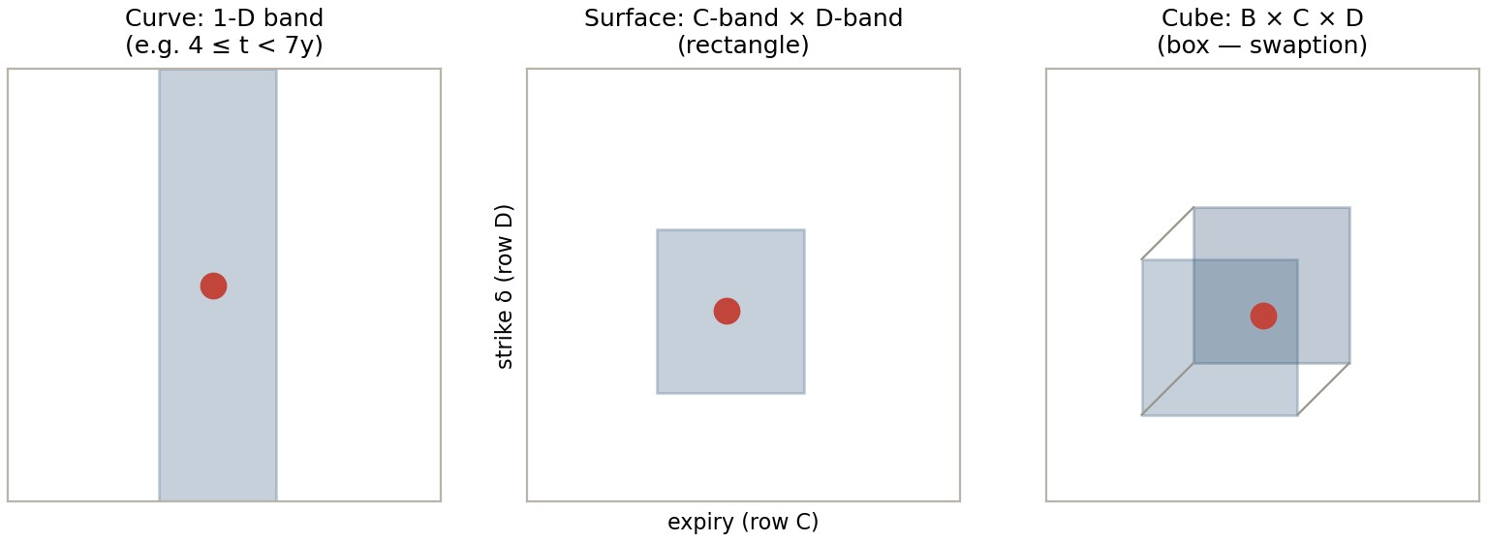
SESSION 2 · ONE PICTURE
EXCEL → 30_instrument_coverage
diagram + exact-match block
A bucket is the INTERSECTION of one band per axis — and categorical attributes are fixed before you bucket
EXHIBIT 1 Band → rectangle → box (mirrors the workbook diagram)
The risk-factor point (●) must fall inside EVERY band at once — an observation counts only if it lands in the same intersection (31.17).
Fix the categorical coordinates FIRST — currency, curve/index, issuer, seniority, commodity grade — they define WHICH factor you are on (a USD 5Y swap is not a ‘nearby’ EUR 5Y swap). Then bucket only the continuous axes: tenor, expiry, strike δ.
THE TAKEAWAY This geometry belongs to the RISK FACTOR, not to the election: own bucketing draws its own edges but keeps the same band-per-axis structure (31.16(1)(a) forces it).
Source: BCBS MAR31 (in force 01-Jan-2023); workbook MAR31_RFET_Bucketing_Reference_v23.xlsx
Excel: 30_instrument_coverage
14

Slide 15
SESSION 2 · EVERY FAMILY AT ONCE
EXCEL → 30_instrument_coverage
coverage matrix
One matrix covers every instrument family
Risk class | Example | Object | Axes → rows | Sample counting rule
Interest rate | 5Y EUR IRS | curve | maturity → A | counts if maturity ∈ 4–7y (A4)
Interest rate | 2Y-into-5Y fwd-starting swap | surface | start, tenor → B×B | start ∈ 0.75–4y AND tenor ∈ 4–10y
Interest rate | 2Y×10Y swaption vol | cube | B × C × D | tenor ∈ 10–18 AND expiry ∈ 1.5–3.5 AND δ ∈ 0.3–0.7
FX | EURUSD 1Y forward | curve | maturity → A | counts if maturity ∈ 0.75–1.5y (A2)
FX | EURUSD 3M 25Δ RR vol | surface | C × D | expiry ∈ 0–1.5y AND δ ∈ 0.05–0.3
Commodity | WTI 6M future | curve | maturity → A | counts if maturity ∈ 0–0.75y (A1)
Credit | 7Y single-name CDS | curve | maturity → C | counts if maturity ∈ 3.5–7.5y (C3)
Equity | SX5E 1Y δ0.5 vol | surface | C × D | expiry ∈ 0–1.5y AND δ ∈ 0.3–0.7
THE TAKEAWAY Every counting rule in the last column resolves against the Table-1 bands on 20_regulatory_buckets — the 5Y swap (one band) and the 2Y×10Y swaption (a 3-D box) between them span the whole machinery.
Tool notes — the workbook is ILLUSTRATIVE: (1) the B×B second maturity axis is not auto-bucketed (curves, C×D surfaces and the swaption cube are); (2) the 90-day density rule is proxied by a max-drought test — permissive by construction, so a FAIL is final but production reliance on a PASS needs the literal 4-per-window check (noted on 70). Real-life use requires judgement throughout.
Source: BCBS MAR31 (in force 01-Jan-2023); workbook MAR31_RFET_Bucketing_Reference_v23.xlsx
Excel: 30_instrument_coverage
15

Slide 16
SESSION 3
Own vs Regulatory & the Guardrail
Excel sheets: 40_own_vs_regulatory · 45_guardrail

Slide 17
SESSION 3 · THE TWO REGIMES
EXCEL → 40_own_vs_regulatory
comparison rows 4–13
Own = your grid, one factor per bucket; regulatory = BCBS's grid, pooling allowed
Dimension | OWN (31.16(1)) | REGULATORY (31.16(2))
Who draws the buckets | the bank | BCBS — Table 1, fixed
Factors per bucket | exactly ONE (31.16(1)(a)) | may be SEVERAL — obs pool across all (31.17)
Bucket vs RTPL | bucket ≡ one RTPL factor (fn 5: same segmentation) | bucket only COUNTS; RTPL keeps its own finer grid
Pooling | across TENOR SPACE only — a wide bucket over unclaimed tenors (route 4); never another factor's prints | across FACTORS too — every print in a band counts for each factor in it (31.17)
PLA effect | widening a bucket = coarsening RTPL → PLA risk | none — RTPL untouched
Evidence burden | cleanest: no borrowed modellability | representativeness bill on borrowed prints
Best for | liquid pillars; parametric models; coarse models | thin/illiquid tenors; sparse surfaces
THE TAKEAWAY An RFET bucket only counts prices; it never sets RTPL. PLA fails when the RTPL GRID is coarse — not because a counting bucket is wide. Keep those two objects separate and the whole chapter simplifies.
Source: BCBS MAR31 (in force 01-Jan-2023); workbook MAR31_RFET_Bucketing_Reference_v23.xlsx
Excel: 40_own_vs_regulatory
17

Slide 18
SESSION 3 · WHAT THE RULE ACTUALLY FORBIDS
EXCEL → 40_own_vs_regulatory
notes 15–18
31.16(1)(a) blocks one specific free lunch — and footnote 5 names the trade-off that never disappears
The free lunch. a WIDE self-defined bucket (pool trades → pass the RFET) sitting over a FINE RTPL (pass PLA). Under the own approach each bucket must equal one RTPL factor, so the combination is impossible by construction.
THE THREE OBJECTS
Risk factor
a model point the engine reprices — lives in RTPL
RFET bucket
a counting window for real prices — lives in MAR31.16
SA bucket (MAR21)
a currency/sector GROUP for aggregation — same word, different world
Want CROSS-FACTOR pooling? Use BCBS's grid. the regulatory election is the sanctioned pooling route — only the grid may pool another pillar's prints — the width is theirs, not yours. Space-capture (route 4) stays open under own.
Footnote 5 verbatim gist. same buckets/segmentation must serve the PLA test and the RFET; finer buckets help PLA but starve each bucket of prices. The trade-off is INVARIANT — under the regulatory election it relocates from raw counts to representativeness quality.
The pincer (Session 3 preview). and the SA floor caps own-bucket width from below — next slides.
Source: BCBS MAR31 (in force 01-Jan-2023); workbook MAR31_RFET_Bucketing_Reference_v23.xlsx
Excel: 40_own_vs_regulatory notes · 45_guardrail §0
18

Slide 19
SESSION 3 · THE FLOOR UNDER EVERYTHING
EXCEL → 45_guardrail
§1–§2
MAR31.3: the model must contain every SA risk factor — so the SA vertex grid caps how coarse own buckets can get
The floor. the IMA model MUST include all standardised-approach risk factors for the class (MAR20–22); omissions need supervisory sign-off (31.3(1)). The RTPL grid therefore contains the SA vertices — and is usually finer.
The vertex sets. GIRR: 0.25 / 0.5 / 1 / 2 / 3 / 5 / 10 / 15 / 20 / 30y (MAR21.8). Credit spread non-sec: 0.5 / 1 / 3 / 5 / 10y (MAR21.9). A 7Y credit factor is a bank-ADDED pillar — the SA grid jumps 5Y → 10Y.
The cap on coarseness. own buckets may absorb bank-added pillars (drop the 7Y, widen the 5Y bucket) but may NEVER span two SA vertices: keep 5Y & 10Y separate and a 5–10Y own bucket holds two RTPL factors (31.16(1)(a) violation); merge them and you breach the floor itself.
THE TAKEAWAY Own-bucket width ≡ RTPL factor width, and RTPL bottoms out at the SA vertex grid. Legal coarsening stops at the floor — everything wider needs the supervisor to sign off an SA omission, which a desk with material exposure will not get.
Source: BCBS MAR31 (in force 01-Jan-2023); workbook MAR31_RFET_Bucketing_Reference_v23.xlsx
Excel: 45_guardrail §1–2 · 90_citations MAR21 row
19

Slide 20
SESSION 3 · THE THIN TENOR PLAYBOOK
EXCEL → 45_guardrail
§3 — routes table
A thin 7Y: four routes — two honest, one sanctioned, one blocked
Route | What you do | Outcome
1 · Keep fine → NMRF | leave 7Y as its own factor; it fails the RFET on ~12 trades | HONEST — SES add-on; RTPL fine, PLA fine
2a · Blend 5–10Y (own) | merge 5Y/7Y/10Y into one blended factor | BLOCKED ex ante — swallows SA vertices 5Y & 10Y, breaches the 31.3 floor
2b · Drop the 7Y, interpolate | delete the bank-added 7Y; reprice off 5Y/10Y; widen the 5Y own bucket to absorb 7Y trades | LEGAL — passes RFET, but coarse RTPL → fails PLA (next slide)
3 · Regulatory pooling | elect the BCBS grid; the 3.5–7.5y band pools the 7Y's trades with the 5Y's | PASSES RFET, RTPL keeps 5Y & 7Y separate → PLA safe — the sanctioned escape
4 · Own-capture (no-man's-land) | draw the 7Y's OWN bucket around active 6Y prints — legal because NO 6Y factor exists | PASSES RFET on captured prints, zero PLA cost — cleanest when liquidity sits between pillars (anatomy slide)
THE TAKEAWAY Route 3 exists precisely so that route 2 never tempts you: pooling without touching the model grid. The RFET bucket counts; RTPL prices; PLA judges RTPL.
Source: BCBS MAR31 (in force 01-Jan-2023); workbook MAR31_RFET_Bucketing_Reference_v23.xlsx
Excel: 45_guardrail §3
20

Slide 21
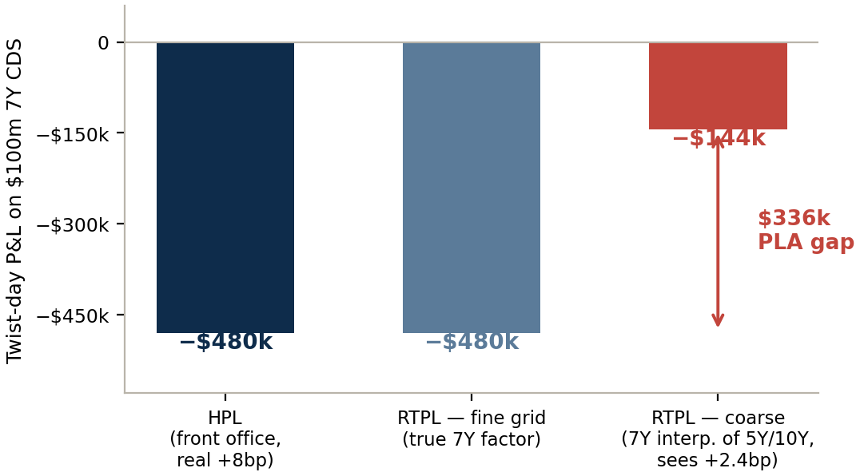
SESSION 3 · WHY ROUTE 2B SELF-DESTRUCTS
EXCEL → 45_guardrail
§4–§5 worked example
The twist day: the coarse engine cannot see the move it deleted — $336k gap, then the PLA red zone
EXHIBIT 2 Route 2b — $100m 7Y CDS, CS01 $60k/bp; twist +2/+8/+3bp (5Y/7Y/10Y)
Calm days match. parallel +5bp: HPL = RTPL = −$300k. The coarseness is invisible — until the curve twists.
Twist days diverge. front office reprices the real +8bp (−$480k); the interpolating engine sees +2.4bp (−$144k). It no longer owns a 7Y factor to carry the hump.
The chain. gaps repeat on every twist → Spearman ↓ (0.95 → 0.72, amber-side) and KS > 0.12 (red on its own; MAR32.42) → desk in the PLA RED zone → loses IMA → whole desk to SA (MAR32.43).
The irony. the capital jump from losing IMA dwarfs the NMRF add-on the desk tried to dodge.
Source: BCBS MAR31 (in force 01-Jan-2023); workbook MAR31_RFET_Bucketing_Reference_v23.xlsx
Excel: 45_guardrail §4–5
21

Slide 22
SESSION 3 · WHO ELECTS WHAT
EXCEL → 40_own_vs_regulatory
election table rows 22–37
The election is per curve / surface / cube — same product, opposite elections is normal
Object | Profile | Election | Why
EUR swap curve | all pillars liquid | OWN | each pillar on its own trades — cleanest evidence
HUF swap curve | only 2/5/10Y trade | REGULATORY (A) | thin tenors pool inside A-bands — same product, opposite election
ACME CDS curve | 7Y thin (~12 prints) | REGULATORY (C) | 3.5–7.5y band pools 5Y+7Y — route 3
DEF CDS curve | index name, quoted daily | OWN | nothing borrowed, nothing to defend
EUR swaption cube | benchmarks daily, wings sparse | REGULATORY (B×C×D) | off-benchmark points ride the boxes
EURUSD vol surface | 3-param smile, liquid pillars | OWN | buckets ≡ ATM/RR/BF factors (31.19); no fn6 conversion
USDTRY vol surface | patchy quotes | REGULATORY (C×D) | sparse strikes/expiries pool — same product, opposite election
THE TAKEAWAY Within one object mixing has NO payoff: under a regulatory election the liquid points still pass on their own prints; the thin points get the pooling. The election picks the dominant regime per object — never per trade.
Source: BCBS MAR31 (in force 01-Jan-2023); workbook MAR31_RFET_Bucketing_Reference_v23.xlsx
Excel: 40_own_vs_regulatory rows 22–37
22

Slide 23
SESSION 3 · ONE ELECTION, DISSECTED
EXCEL → 40_own_vs_regulatory
anatomy rows 39-48
The HUF curve tenor by tenor — a passing factor cannot pass harder, so never split an object
Tenor (liquidity) | Row-A band | Liquid neighbour in band | Verdict — whole-curve REGULATORY election
2Y — liquid | 1.5-4y | — (itself) | passes on its OWN prints — exactly what own bucketing would give
3Y — sporadic | 1.5-4y | the 2Y | borrows the 2Y's prints → passes (31.17)
5Y — liquid | 4-7y | — (itself) | passes on its own prints
6Y — sporadic | 4-7y | the 5Y | borrows → passes
7Y — sporadic | 7-12y — NOT in 4-7y (bands closed-left, open-right) | the 10Y | borrows the 10Y's prints → passes
10Y — liquid | 7-12y | — (itself) | passes on its own prints
15Y — sporadic | 12-18y | NONE — no liquid occupant | STILL FAILS → NMRF: pooling never crosses a band boundary — the subsidy's hard edge, same as the swaption wings
THE TAKEAWAY Register rule — ask from WHERE you borrow: another FACTOR's pillars (3Y ← 2Y) → only the regulatory grid pools across factors → REGULATORY. Unclaimed tenor space (a thin 7Y drawing its own bucket [6y, 7.5y) around plentiful 6Y prints, where NO factor lives) → OWN captures it: one factor in the bucket, zero PLA cost, a one-year representativeness reach. No borrowing at all → OWN. (Route 4 worked on the workbook: 40 rows 50–52.)
Source: BCBS MAR31 (in force 01-Jan-2023); workbook MAR31_RFET_Bucketing_Reference_v23.xlsx
Excel: 40_own_vs_regulatory rows 39-48
23

Slide 24
SESSION 3 · GOVERNANCE
EXCEL → 40_own_vs_regulatory
documentation map rows 54–55
Where the election lives — five artefacts a supervisor will ask for
1 · Modellability / RFET policy. the 31.15 policy set: election criteria, representativeness and mapping rules. Owner: Market Risk Methodology; approved through model governance.
2 · The election register. every curve/surface/cube with its election, rationale, review date — the workbook's election table is a template for it.
3 · The IMA permission file. EU: CRR Art. 325az application; methodology per the RTS under Art. 325be (Delegated Regulation 2022/2060, Art. 5(1): election ‘for each curve, surface or cube’).
4 · Model change framework. switching an election changes RFET outcomes — documented change, validation review, supervisor notification where material. Never a quarterly convenience.
5 · Validation, audit & the quarterly RFET pack. both reference the register; the quarterly results are the register's heartbeat.
Source: BCBS MAR31 (in force 01-Jan-2023); workbook MAR31_RFET_Bucketing_Reference_v23.xlsx
Excel: 40_own_vs_regulatory rows 54–55
24

Slide 25
SESSION 4
Special Cases & the Numbers
Excel sheets: 50_special_cases · 55_systematic_proxy_nmrf

Slide 26
SESSION 4 · 31.17, BOTH SENTENCES
EXCEL → 50_special_cases
rows 21–30
Pooling is a subsidy with a bill attached — every borrowed print must be REPRESENTATIVE
Sentence 1 (the subsidy): all prices in a bucket count toward EVERY factor in it — 40 ACME 5Y prints + 12 at 7Y = 52 obs for both factors. Sentence 2 (the bill): each print must be representative of the factors it counts for — extractable value, documented mapping (31.15).
Candidate print (3.5–7.5y band) | Representative of ACME 7Y? | Counts?
ACME 5Y CDS trade | YES — same name/seniority/doc; curve extracts 7Y from 5Y | ✓ the legitimate borrow
DEF Corp 5Y CDS trade | NO — different issuer = different factor; tenor was never the only coordinate | ✗
iTraxx Europe 5Y index trade | only of the SYSTEMATIC sector factor (31.20) | ✗ for ACME (✓ for the sector curve)
ACME 3.6y trade → 7.4y factor | STRETCH — thin extraction claim; supervisor may challenge; 31.23 backstop | ✓ only if defended
THE TAKEAWAY Pooling converts a COUNTING problem into an EVIDENCE problem — the marginal prints that lift you over 24 are exactly the ones resting on an argument, not identity. Under own bucketing sentence 2 barely arises: nothing is borrowed.
Source: BCBS MAR31 (in force 01-Jan-2023); workbook MAR31_RFET_Bucketing_Reference_v23.xlsx
Excel: 50_special_cases rows 21–30
26

Slide 27
SESSION 4 · TWO MAINTENANCE RULES
EXCEL → 50_special_cases
maintenance table rows 5–9
31.18 lets observations age gracefully; 31.19 moves the test to the calibration inputs
31.18 — AGEING / ROLL-DOWN
31.19 — PARAMETRIC CURVES & SURFACES
Observations usually STAY in the maturity bucket they were allocated to, even as the instrument rolls down the curve.
When a credit-spread point is no longer modelled, its prices may move to the adjacent SHORTER bucket (fn 7: a 4Y bond observed at issuance 8 months ago → the 1.5–3.5y bucket).
Hard rule: each price counts in ONE maturity bucket only — no double-counting.
If the risk factors are PARAMETERS of a functional form (SABR β, Nelson-Siegel, the FX smile's ATM/RR/BF), the RFET is passed on the MARKET DATA used to calibrate them.
You cannot observe ‘the SABR β’ in the market — so test the inputs.
FX is the friendly case: the calibration inputs are themselves committed broker quotes (Session 4, FX smile slide).
THE TAKEAWAY Both rules answer the same audit question — ‘where exactly is each observation counted, and why there?’ — one in time, one in model space.
Source: BCBS MAR31 (in force 01-Jan-2023); workbook MAR31_RFET_Bucketing_Reference_v23.xlsx
Excel: 50_special_cases
27

Slide 28
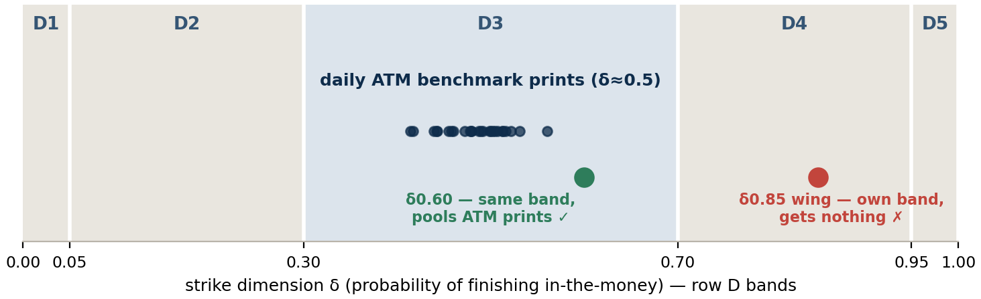
SESSION 4 · 31.17 IN THREE DIMENSIONS
EXCEL → 50_special_cases
cube walkthrough rows 32–39
The swaption cube: benchmark liquidity carries the boxes — but pooling never crosses a band boundary
EXHIBIT 3 Strike axis of the cube — who gets to borrow the daily ATM prints
What prints daily. benchmark expiry×tenor ATM quotes (1Y×10Y, 2Y×10Y, 5Y×5Y…) — each one an observation at (expiry, tenor, δ≈0.5).
Who it helps. off-benchmark points sharing the FULL 3-D box: (2.5Y, 12Y, δ0.60) sits in C2×B4×D3 with the 2Y×10Y benchmark → ~250 prints/yr → modellable.
Who it cannot help. the δ0.85 wing lives in D4 — ATM prints count for NOTHING there; without real OTM/collar flow it stays NMRF. Deep wings (D1/D5) are the classic residual NMRFs.
Source: BCBS MAR31 (in force 01-Jan-2023); workbook MAR31_RFET_Bucketing_Reference_v23.xlsx
Excel: 50_special_cases rows 32–39
28

Slide 29
SESSION 4 · 31.19 WORKED
EXCEL → 50_special_cases
FX smile rows 41–48
The FX smile in three parameters — own buckets ≡ the parameter factors, RFET on the quotes
Quoted instrument | Smile role | 1Y EURUSD (illustrative)
ATM straddle vol | LEVEL | 7.0%
25Δ risk reversal (RR) | SKEW — vol(25Δ call) − vol(25Δ put) | −0.8%
25Δ butterfly (BF) | CURVATURE — avg(wings) − ATM | +0.25%
→ reconstructed 25Δ put | ATM + BF − RR/2 | 7.65%
→ reconstructed 25Δ call | ATM + BF + RR/2 − RR | 6.85%
The model stores 3 parameters per expiry pillar. ATM/RR/BF — not a strike grid. Those ARE the RTPL factors (31.19: test the calibration quotes, which here are committed broker quotes).
Why OWN. one factor per bucket is trivially satisfiable — draw strike ranges matching each parameter; pillars are deeply liquid, so every bucket eats its own quotes.
Why not regulatory. row-D bands don't map to ATM/RR/BF, the desk needs no pooling, and the fn6 market-Δ → regulatory-δ conversion is avoided entirely.
THE TAKEAWAY Mirror image of the cube: sparse off-benchmark points → elect regulatory for the subsidy; liquid parametric pillars → elect own and skip the overhead.
Source: BCBS MAR31 (in force 01-Jan-2023); workbook MAR31_RFET_Bucketing_Reference_v23.xlsx
Excel: 50_special_cases rows 41–48
29

Slide 30
SESSION 4 · 31.20 / 31.21
EXCEL → 50_special_cases
rows 11–19
Systematic factors ride the index; the idiosyncratic residual pays its own way or goes NMRF
The permission (31.20). market/region/sector factors are modellable on index and constituent trades — IF they share the factor's attributes (region, quality, sector).
THE DESK PICTURE
ACME bond ≈ sector factor + name residual
Sector factor: backed by iTraxx / sector index — modellable, into ES.
Residual: ACME prints ~12/yr — NMRF, SES add-on.
Session 4's next two slides put NUMBERS on exactly this split.
The limit. the issuer-specific residual is NMRF unless that issuer itself prints ≥24 real prices — no free ride on the index's liquidity.
The maturity axis (31.21). even a market-wide credit curve gets bucketed on tenor — row C — before its index prints can be counted.
Equity analogue. sector beta factor modellable from the index; the single-stock residual stands alone.
Source: BCBS MAR31 (in force 01-Jan-2023); workbook MAR31_RFET_Bucketing_Reference_v23.xlsx
Excel: 50_special_cases rows 11–19
30

Slide 31
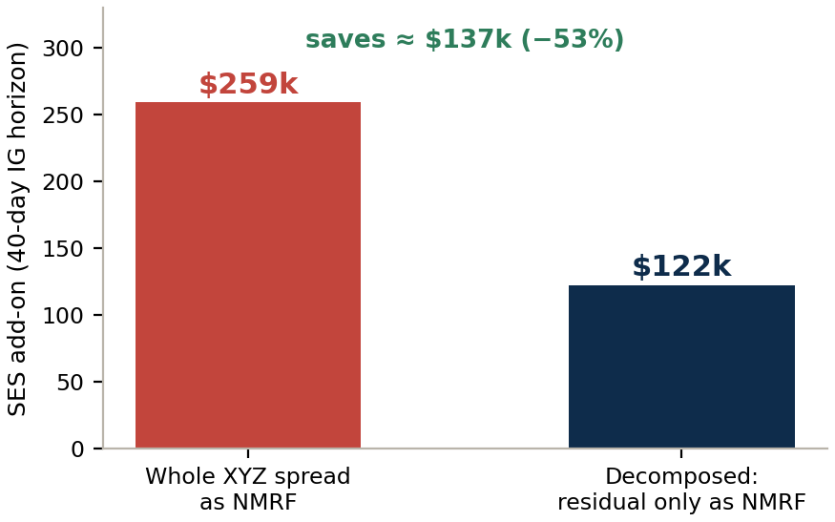
SESSION 4 · THE SPLIT, QUANTIFIED
EXCEL → 55_systematic_proxy_nmrf
§1 — credit
β = 1.25, R² = 0.78: decomposing XYZ Corp halves the NMRF bill
Quantity | Value | How
Regression (2y weekly, vendor marks — 31.22) | Δs_XYZ = 1.25·Δs_SECTOR + ε | OLS; re-estimate ≥ every 2 weeks (P5)
σ weekly — sector / residual | 6.0bp / 4.0bp | sample st.dev. / residuals
R² — variance explained | 56.25 / 72.25 ≈ 0.78 | must be ‘significant’ (P7a)
Sector factor | MODELLABLE — index trades represent it (31.20) | → ES
Residual | NMRF — XYZ prints 12/yr < 24 | → SES (MAR33.16)
EXHIBIT 4 SES on $10m 5Y (CS01 $4.6k/bp), 40-day LH
How the stressed moves are built: weekly σ × √8 weeks × 2.34 (97.5% ES multiplier), σ from the worst 12-month window — whole spread 8.5bp → ≈56bp → $259k; residual 4bp → ≈26bp → $122k.
Bonus: idiosyncratic credit NMRFs may aggregate at ZERO correlation across names (33.16(2)) — the decomposition saving compounds across the book.
Source: BCBS MAR31 (in force 01-Jan-2023); workbook MAR31_RFET_Bucketing_Reference_v23.xlsx
Excel: 55_systematic_proxy_nmrf §1
31

Slide 32
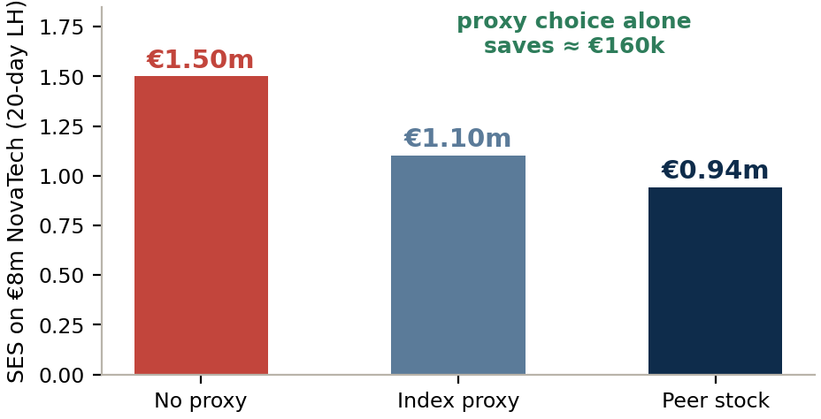
SESSION 4 · CHOOSING THE SUBSTITUTE
EXCEL → 55_systematic_proxy_nmrf
§2 — equity
Proxy selection is a P7 scoring exercise — and the choice is worth €160k on one name
Candidate | Region | Sub-industry | Size | β | ρ (R²) | Residual σ/wk
STOXX 600 Tech index | Europe ~ | Tech ~ | large ✗ | 1.10 | 0.68 (0.46) | 2.9%
TechnoSys SE — peer stock | DACH ✓ | ind. software ✓ | mid ✓ | 0.95 | 0.78 (0.61) | 2.5%
P7(b), the RTPL rule: the PROXY representation (0.95 × TechnoSys) — not NovaTech — goes into RTPL, unless the basis is identified and capitalised (ES if modellable, else NMRF). Only then may RTPL carry proxy+basis or the actual factor.
This alignment rule is the single most common remediation for PLA failures on proxied books — the capital mapping and the RTPL mapping must be the SAME mapping.
EXHIBIT 5 Basis NMRF on €8m NovaTech (20-day LH)
THE TAKEAWAY A better proxy buys THREE things at once: a smaller basis NMRF, an RTPL that tracks HPL, and a defensible P7 file. Score candidates on attributes + ρ, never on convenience.
Source: BCBS MAR31 (in force 01-Jan-2023); workbook MAR31_RFET_Bucketing_Reference_v23.xlsx
Excel: 55_systematic_proxy_nmrf §2
32

Slide 33
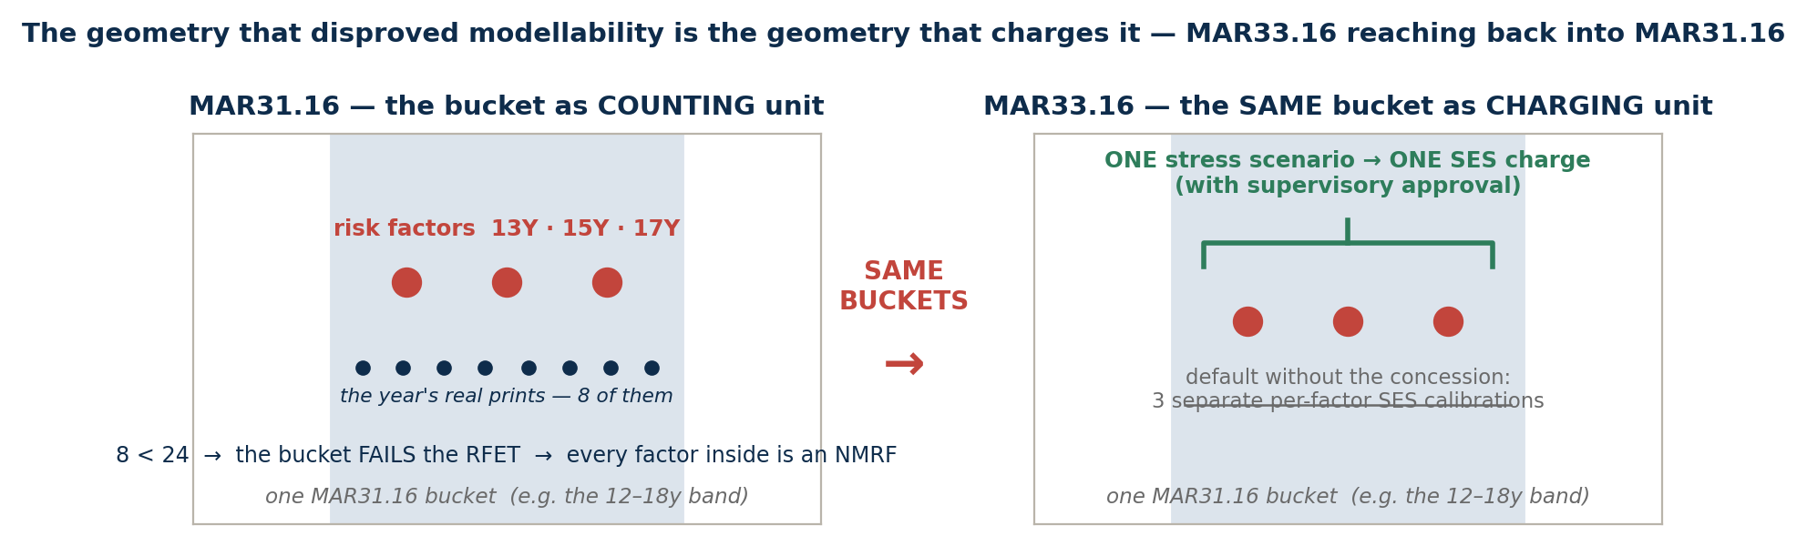
SESSION 4 · THE MAR33 LOOP-BACK
EXCEL → 55_systematic_proxy_nmrf
note + diagram, rows 39-41
The bucket that failed you is the bucket that bills you — bucket-level SES (33.16)
EXHIBIT 6 One bucket, two roles — counting unit (31.16) and charging unit (33.16)
The default. each NMRF gets its own calibrated stress SCENARIO — hundreds of separate calibrations on a real book. The stress PERIOD is already common: ONE 12-month window per RISK CLASS (33.16), never per factor or per bucket.
The concession. with approval, ONE joint scenario per MAR31.16 bucket — the SAME buckets that disproved modellability. Consolidating the scenario also implicitly NETS exposures within the bucket (a long-13Y / short-15Y pair offsets, where per-factor scenarios stress both legs adversely) — the geometry that earned the pooling benefit is the only one allowed to earn the netting benefit. It changes how the SES bill is computed, never who owes it.
Source: BCBS MAR31 (in force 01-Jan-2023); workbook MAR31_RFET_Bucketing_Reference_v23.xlsx
Excel: 55_systematic_proxy_nmrf rows 39-41
33

Slide 34
SESSION 5
The Seven Principles, the Live Demo & the Wrap
Excel sheets: 57_seven_principles · 60_calculator · 70_rfet_results · 90_citations

Slide 35
SESSION 5 · THE RENT
EXCEL → 57_seven_principles
Seven data principles — what a factor must keep proving AFTER it passes the RFET
# | Principle | One line | Bites in the workbook at
P1 | Combinations & interpolation | derived-from-modellable is modellable; interpolation must match the PLA/RTPL mapping; extrapolation limited + supervised | 45 (RTPL grid), 50 (31.19)
P2 | Idio AND general risk | whichever component the data can't support → NMRF that part | 50 (31.20) · 55 §1
P3 | Vol & correlation fidelity | no smoothing away volatility; correlations ≈ correlations among real prices | 05 §1 (smooth-series)
P4 | Reflective of real prices | the standing recon: risk prices vs FO/BO vs real observations | 05 §2 (POLICE)
P5 | Update frequency | two clocks: model DATA refreshed at least MONTHLY, ideally daily; regression parameters (β's) re-run at least once every 2 WEEKS — that is the refresh cadence, the estimation window itself stays long (e.g. 2y of weekly points) | 55 (β re-estimation flags)
P6 | Stress-period data | stressed-ES data from the actual stress window, else omit factor & keep the 75% reduced-set test | 55 (stress-window σ)
P7 | Proxies | limited, similar (region/quality/type), empirical betas; P7(b): proxy goes into RTPL unless basis capitalised | 55 §2 — the punchline
THE TAKEAWAY Enforcement is 31.23: principles unmet ⇒ the supervisor deems the data unsuitable and the factor becomes an NMRF DESPITE its RFET pass. Counting gets you in; governance keeps you in.
Source: BCBS MAR31 (in force 01-Jan-2023); workbook MAR31_RFET_Bucketing_Reference_v23.xlsx
Excel: 57_seven_principles
35

Slide 36
SESSION 5 · P1 / P6 / P7(B) IN DEPTH
EXCEL → 57_seven_principles
P1 / P6 / P7 rows
P1, P6 and P7(b) — the three principles where models actually get challenged
P1 — INTERPOLATION DISCIPLINE
P6 — THE STRESS WINDOW
P7(b) — THE RTPL/PROXY ALIGNMENT
Interpolating between modellable points is fine — but the interpolation must use the SAME mapping as RTPL, never a broader alternative bucketing. Extrapolation: only a reasonable distance, from MORE than one modellable factor, with supervisory approval, and reflected in RTPL. The quiet echo of 31.16(1)(a).
EXAMPLE the model needs a EUR 6Y rate. RTPL interpolates it from the 5Y and 7Y factors — so the ES data must use those SAME two neighbours with the same weights, never a broader 4–10y scheme. A 42Y exposure beyond the 30Y point: extrapolate from more than one anchor (20Y & 30Y), with approval, mirrored in RTPL.
Stressed-ES data must come from the actual stress period. Can't justify it? OMIT the factor from the stressed calculation — and the reduced factor set must still explain ≥75% of the full ES (MAR33.5(2)(b)). Name-specific factors that didn't exist in 2008: their idio part is presumed OUT of the reduced set.
EXAMPLE the stress window is 2008–09, but XYZ Corp first issued debt in 2015. Its name-specific factor cannot be evidenced in that window → the idio part drops out of the reduced set, the exposure maps to the EUR IG-Industrials sector factor for the stressed ES, and the reduced set must still clear the 75% test.
If a proxy represents the factor in ES, the PROXY must be what RTPL carries — unless the basis is identified and capitalised. Books that proxy in capital but use actual factors in RTPL fail PLA for a reason they can't see. The most common single remediation on proxied desks.
EXAMPLE ES capitalises NovaTech as 0.95 × TechnoSys plus a basis NMRF (55 §2). RTPL must carry that SAME 0.95 × TechnoSys — or, once the basis is capitalised, the actual NovaTech factor. The failure mode: proxy in capital, raw NovaTech marks in RTPL — the basis then pollutes HPL−RTPL every single day.
THE TAKEAWAY One sentence to retain: the mapping used for CAPITAL must equal the mapping that builds RTPL — P1 says it for interpolation, P7(b) for proxies, 31.16(1)(a) for buckets.
Source: BCBS MAR31 (in force 01-Jan-2023); workbook MAR31_RFET_Bucketing_Reference_v23.xlsx
Excel: 57_seven_principles
36

Slide 37
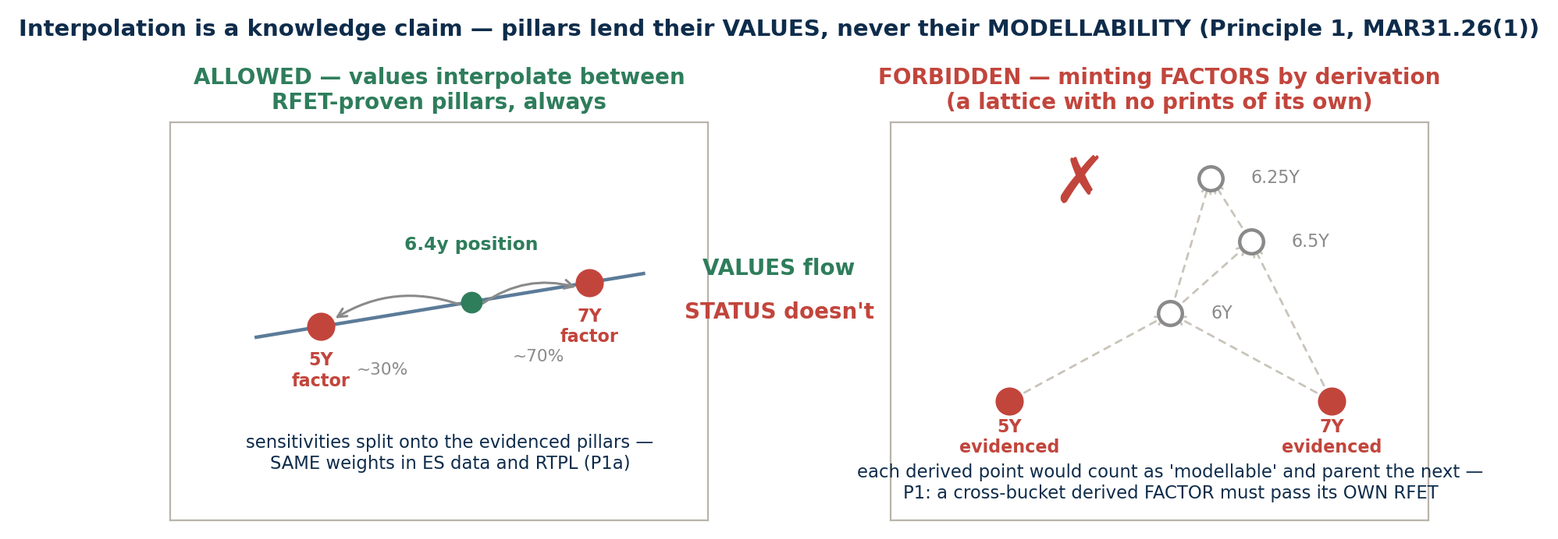
SESSION 5 · P1, ONE LEVEL DEEPER
EXCEL → 57_seven_principles
note + diagram, rows 14-16
Interpolation is a knowledge claim — pillars lend their VALUES, never their modellability
EXHIBIT 7 Two allocation systems, one clamp — the P1 cross-bucket rule
Prints vs sensitivities. buckets allocate PRINTS discretely (one bucket per price, 31.18); interpolation allocates SENSITIVITIES continuously (same weights in ES data and RTPL, P1a). A bucket's pillar answers the counting question — never the pricing one.
The bet the mapping places. an interpolated point is built from adjacent RFET-proven pillars and ASSERTS it carries no risk beyond what they imply — PLA tests that assertion daily; when it fails, the point earns its own factor (own RFET) or an NMRF charge for the residual. Compression of evidence is welcome; multiplication of it is not.
Source: BCBS MAR31 (in force 01-Jan-2023); workbook MAR31_RFET_Bucketing_Reference_v23.xlsx
Excel: 57_seven_principles rows 14-16
37

Slide 38
SESSION 5 · LIVE DEMO — INPUTS
EXCEL → 60_calculator
white = input, grey = derived
The calculator: one row per observation, every derivation visible
Column(s) | What it does | What it demonstrates
B — obs date · S — real price? (Y/N) | the evidence: when, and does it qualify under 31.12 | a single S→N flip is enough to fail a borderline factor
D–H — class / object / vol / swaption / several-dims | drives the row logic (a)–(f) | the K-column formula resolves rules (a)–(f) mechanically
J, N, Q — dim values (years, δ) | the coordinates on each continuous axis | the boundary case: t = 0.75 lands in bucket 2, never 1
K/L, O/P, R — rows & buckets | MATCH against the Table-1 lower bounds (named ranges) | closed-left / open-right semantics, cell by cell
T — risk-factor key | class|object|buckets — the pooling identity (31.17) | two different tenors, one key — that IS the pooling
U — days to next obs · V — 1st-of-day flag | drought metric + the one-per-day cap (31.13) | a duplicated date leaves the count unchanged (1/day cap)
THE TAKEAWAY Everything the RFET needs is derived on-sheet from raw observations — no macros, no hidden logic. The audience can rebuild any cell from the MAR31 text beside it.
Everything hangs off the as-of date: currently 2026-06-28 — move it, and the 12-month window, the counts and every verdict slide with it.
Source: BCBS MAR31 (in force 01-Jan-2023); workbook MAR31_RFET_Bucketing_Reference_v23.xlsx
Excel: 60_calculator
38

Slide 39
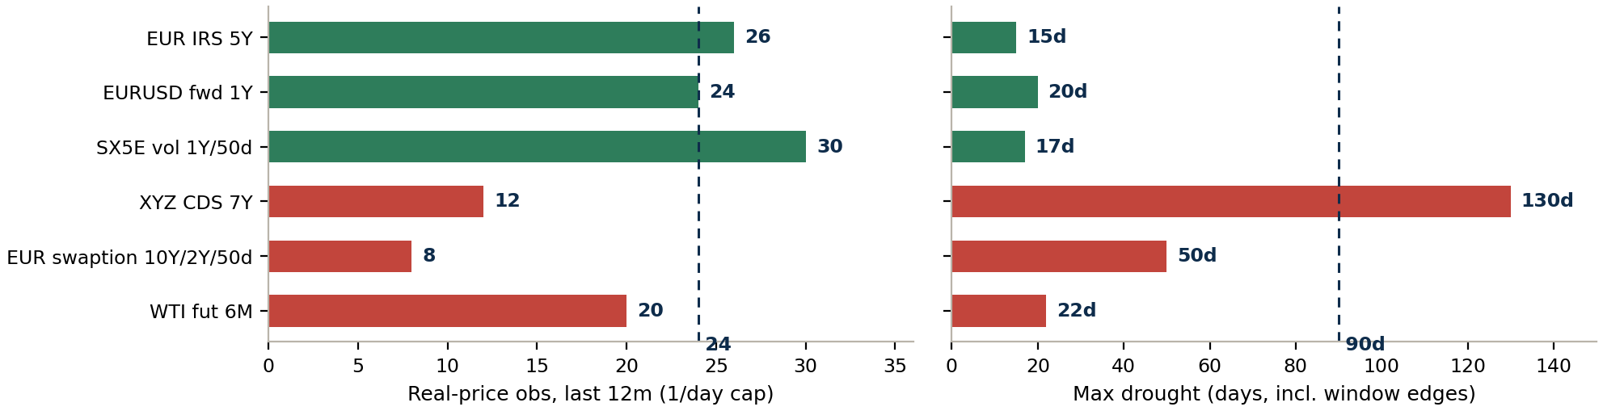
SESSION 5 · LIVE DEMO — VERDICTS
EXCEL → 70_rfet_results
conditional formatting tells the story
Six factors, six verdicts — each one fails (or passes) for a different reason
EXHIBIT 8 Live results read from the workbook (as-of 2026-06-28)
Every verdict has a different cause. FX passes at EXACTLY 24 — one lost print would flip it. WTI has fine density (22d) but count 20 < 24. Credit has count AND a 130-day drought. The swaption cube is simply sparse.
The panel is live, not a picture. remove two FX observations on 60_calculator and the EURUSD row turns PASS → FAIL — the test is transparent down to the individual print.
Source: BCBS MAR31 (in force 01-Jan-2023); workbook MAR31_RFET_Bucketing_Reference_v23.xlsx
Excel: 70_rfet_results
39

Slide 40
SESSION 5 · WRAP
EXCEL → 90_citations
every anchor, verbatim
Seven questions you should now be able to answer cold
The question | The answer in one line | Where
Is a CMS a several-maturity-dims factor? | No — the 10Y tenor is PINNED (categorical); only the start varies → row A | 10_decision_map
Can an own bucket span 5Y and 10Y? | Only by coarsening RTPL across two SA vertices — blocked by the 31.3 floor + 31.16(1)(a) pincer | 45_guardrail
Do the swaption wings borrow ATM prints? | Never across a D-band boundary — only full-box sharers pool | 50 rows 32–39
Can I mix own & regulatory? | Across objects, yes (per curve/surface/cube); within one object, no — and there's no payoff anyway | 40 rows 22–37
Is a market '25Δ' at regulatory δ = 0.25? | No — Δ is the hedge ratio N(d₁), δ is P(ITM) = N(d₂); on the wings the wedge flips D-bands → fn6 conversion is mandatory | 20 row 34
Can an interpolated point inherit modellability? | Never — pillars lend VALUES, not STATUS; a cross-bucket derived FACTOR passes its own RFET or stays a pricing point | 57 rows 14–16
Can I discard prices after passing? | No — quarterly gate, Principle-4 recon, evidence on demand; only CALIBRATION moves on (31.22) | 05 §2
THE TAKEAWAY The one-sentence course: real prices earn capital credit; buckets decide where prices count; the election is per object; RTPL must use the capital mapping; pillars lend values, never status; and the seven principles are the rent. Everything else is worked examples.
Source: BCBS MAR31 (in force 01-Jan-2023); workbook MAR31_RFET_Bucketing_Reference_v23.xlsx
Excel: 90_citations
40

